Slide 1
ATEGORIES OF STRESS AND STRESS MANAGEMENT ACTION PLAN
Student’s Name
Institutional Affiliations

Slide 2
Introduction
The areas sections covered in this in this Presentation are:
      Definition of stress
      4 types of stress
      How stress can be positive
      Action plan for stress management
      Practical stress management action plan application
      Conclusion

Slide 3
Definition of Stress and List of the Types
Stress is defined as mental or physical discomfort due to any factors that elicit response from the body.
Stress is normal
Occurs as to response by the body
Classification of stress based on symptoms
4 types of stress:
      i.) Physical stress
      ii.) Emotional stress
      iii.) Behavioural stress
      iv.) Cognitive stress
There are other ways of classifying stress
Notes:
Stress is the body's reaction to any change that requires an adjustment or response. Stress is a normal part of life, and can be experienced from your environment, body or thoughts ( Stress, 2020). There are other ways of categorizing stress. The American Psychological Association, for instance, categorizes stress into acute, episode acute and chronic depending on the severity of symptoms. Conversely, some give six classes of stress which are psychological, psychosocial, physical, acute, episode acute and chronic (Wallace, 2020). This classification focuses more on triggers for the specific types of stress.

Slide 4
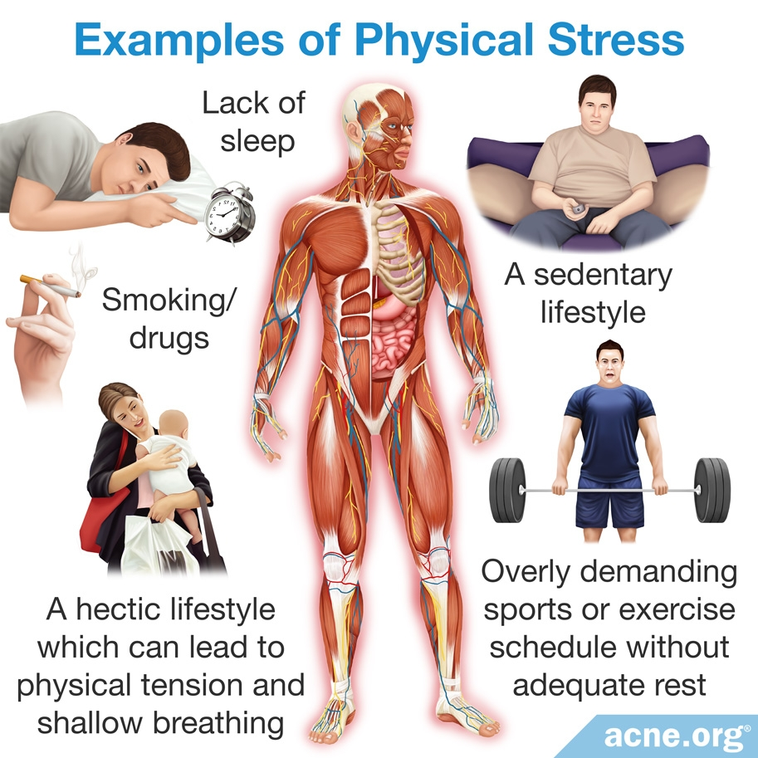
Physical Stress
Physical stress – due to trauma, over-exertion, illness, fatigue etc.
Physical stress example: DOMS- temporary muscle inflammation/ damage
Notes:
Physical stress can be caused by trauma, over-exertion, illness, fatigue, hormonal imbalance, lack of oxygen, surgery, infection or injury ( Wallace, 2020).
Delayed onset muscle soreness (DOMS) is an example of physical stress brought about by rigorous physical exercises. It is characterized by sore muscles between 24 and 48 hours after the exercise, with eccentric muscle contractions resulting in greater disruption to the structural elements of the muscle and connective tissue than concentric exercise, hence DOMS is more intense with eccentric than concentric exercises ( Basham et al, 2019). It however heals on its own after a few days at most. DOMS can also be alleviated using massage of the affected muscle, in addition to reducing the rigor of the exercises used.

Slide 5
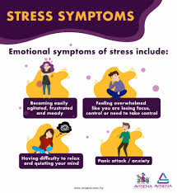
Emotional Stress
Emotional stress – triggers emotional reactions
Traumatic events
PTSD- common example, created by unresolved critical incident stress
May have long term effects
Notes:
Emotional stress is mostly associated with recent traumatic events such as the loss of a person or property. It is characterized by feelings of tension, irritability, restlessness, worries, inability to relax, and depression (Friedman, 2020).
Post traumatic syndrome disorder (PTSD) is a mental health condition triggered by experiencing a terrifying event, and symptoms of PTSD include nightmares or flashbacks, avoidance of situations that bring back the trauma, heightened reactivity to stimuli, anxiety or depressed mood ( Post traumatic syndrome disorder, 2020). Furthermore, PTSD is characterized by avoidance of thoughts about the traumatic experience, implying unresolved mental baggage. The symptoms of PTSD may get better over time depending on severity, but PTSD may have long lasting effects if not dealt with. A mental health professional should be contacted as soon as possible if the subject has a difficulty in returning back to normal.

Slide 6
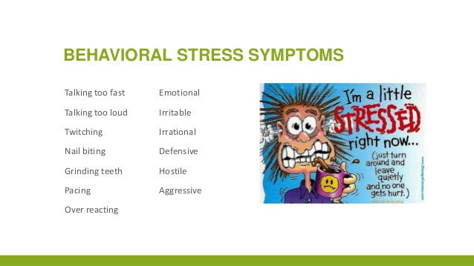
Behavioral Stress
Is a type of chronic stress.
Example -Nail biting (NB)
Suggested to reduce anxiety
Notes:
Behavioral stress manifests in change in behavior over time if the cause of stress is not eliminated. This implies that behavioral stress is a chronic manifestation, meaning it occurs progressively over time and is therefore harder to stop. Behavioral stress takes form in exhibition of more nervous behavior such as nail biting, fidgeting or pacing.
Nail biting, also called onychophagia, has been shown to be a regular symptom of behavioral stress. However, it is not a pathological condition in all cases, with nail biting among healthy children found to be temporary and irregular ( Ghanizadeh, 2011). Ghanizadeh (2011) found that the parents or other family members feel shame from the behavior of their children or siblings who bit their nails, and that the children or adults with NB might be laughed at or stigmatized by others. While some suggest that nail biting may reduce anxiety, research in support of this is insufficient.

Slide 7
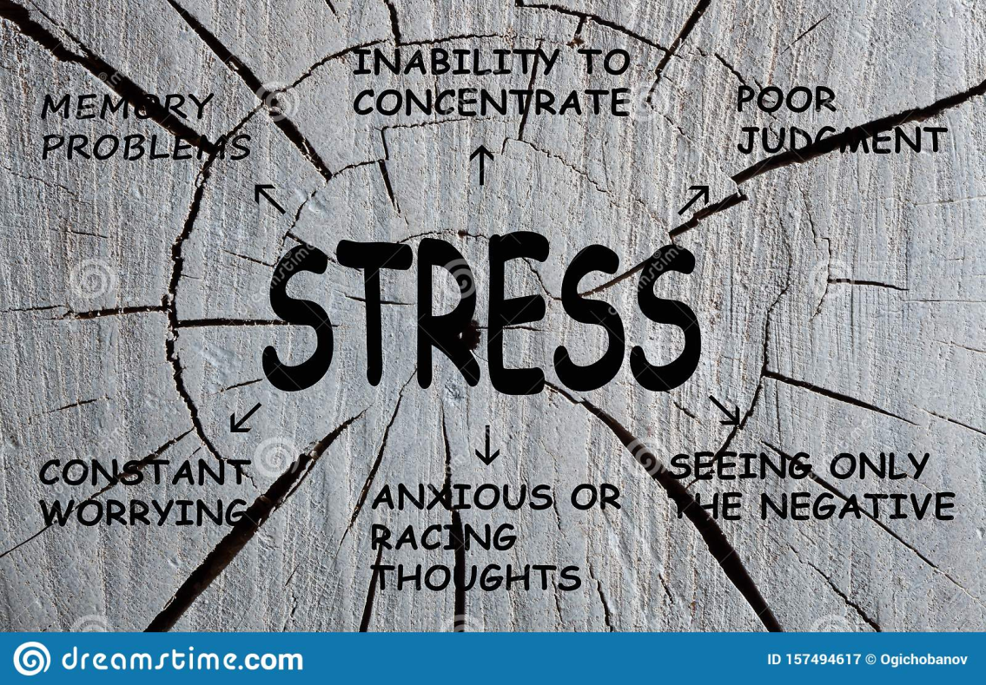
Cognitive Stress
Triggers psychological reactions
Constant worrying, racing thoughts, forgetfulness and disorganization
Example- Identity confusion
Notes:
Symptoms of cognitive stress include constant worrying, racing thoughts, forgetfulness and disorganization, inability to focus, poor judgment and being pessimistic.
Identity confusion in people can manifest in people having trouble defining the things that interest them in life, or their political or religious or social viewpoints, or their sexual orientation, or their professional ambitions. In addition to these apparent alterations, the person may experience distortions in time, place, and situation. It can be brought about by cognitive stress, which affects the mental wellbeing of a person.

Slide 8

How Stress Can be Positive
Not all stress is bad.
Only temporary sources of stress can be beneficial to us.
Stress occurring in a safe context is good.
Example – During play. Control can be surrendered as long as the circumstances are not harmful
Stress can improve immunity (infection)
Notes:
Robert Sapolsky (2012) in a video recorded speech explains the circumstances under which stress can be good. First, he states that humans love stress in just the right amounts that allow us to surrender control while still being in a safe context. He uses an example of a horror movie or a roller coaster ride, both of which are uncomfortable scenarios but can be used in enjoyment. He also adds that for stress to be good, it has to be in moderate levels and transient in nature.
Furthermore, MacMillan (2014) shows that stress can have positive effects. For starters, she shows that immunity can be improved by mild stress, deriving this from a documented Stanford study. Also, she adds that stress can make one more resilient for instance in NAVY Seal training, in addition to motivating one towards success. Finally, she shows that child development can be enhanced by moderate stress, with a 2006 John Hopkins study finding that most children of women who reported mild to moderate stress levels during pregnancy showed greater motor and developmental skills by age 2 than those of unstressed mothers

Slide 9
Stress Management Action Plan
Stress management has many benefits.
For example it helps people deal with stress.
My Biggest source of stress is school.
School is both a long-term and short-term source of stress
It is a source of negative stress due to feelings of self doubt
It is a source of positive stress due to interactions with fellow students in school
Notes:
Stress management refers to practices intended to help people deal with factors that create stress in their lives. Stress management has several benefits, some of which include an improved ability to focus due to better mental clarity, a betterment of physical health and helping one stabilize their emotions to maintain a general state of happiness and life satisfaction. Brown (2020) proposes a framework for creating a stress management plan. This first demands an understanding of how one responds to stress, followed by identification of the stressors in one’s life. People experience stress from different perspectives with varying degrees. The biggest sources of stress in life are generally work, relationships or illnesses. Next, one is required to identify the stress signals that show up, and these are the symptoms of stress such as headaches, confusion and fidgeting. Furthermore, the stressors should be categorized based on whether they have a long or short term effect, as this is seen to be important in mental stress, which gets worse over time if not dealt with. For instance, a long term stressor such as a bad marriage might necessitate marriage counseling, while a short term stressor such as a small injury should not need as much attention. Finally, positive stressors should be identified, and an effort made to enhance them. For instance, if one enjoys horror movies, this habit should b e made more regular but not repeated too much. The negative stressors should be determined with a view to eliminate them. From these, a stress management plan can be devised.
For a personal example, school is the biggest source of stress in my life at the moment. This is because it requires various skills such as learning skills and critical thinking, in addition to social skills and many more. Since it lasts over a number of years, it can be classified as a long term source of stress, with short term stresses arising from daily challenges and assignments. While it can be a negative stress sometimes since it sometimes creates feelings of self doubt and frustration, daily interaction with fellow students is a source of positive stress.

Slide 10
Continued… Stress Management Action Plan
Stress management action plan highlights steps to reduce negative stress effects.
3 categories of actions: action-oriented, emotion-oriented, acceptance-oriented
5 steps suggested to eliminate negative stress :
    Exercise
    Rest
    Proper diet
    Sharing – having a shoulder to cry on
    Play therapy
Notes:
After a clear understanding of how stress influences mental and physical wellbeing, a stress management action plan can be created. Following identification of positive and negative stress sources, one can come up with specific actions that eliminate negative stress and promote positive stress. This approach prioritizes self care. Brown (2020) classifies stress management actions into three categories. These are: Action Orientated Approaches used to take action to change a stressful situation, Emotion-oriented approaches used to change the way we perceive a stressful situation and Acceptance-oriented approaches used for dealing with stressful situations you can’t control. Action oriented ones include assertiveness, time management and creating of boundaries. Emotion oriented steps include affirmations and cognitive restructuring while Acceptance- oriented steps include meditation, sleep, diet and exercise.

Slide 11
Conclusion
Stress affects mental and physical wellbeing.
Not all stress is bad.
Positive stress is more transient and occurs in safe contexts.
Stress Can be classified into 4 main categories: physical, emotional, cognitive and behavioral
Stress management plan helps one deal with stress
Stress management requires understanding of individual stress experience
Notes:
In conclusion, stress can have negative effects on mental and physical wellbeing of a person. However, the right amount of stress can elicit positive effects in people, such as when stress is experienced in a safe context. A stress management action plan is therefore necessary to identify the sources of negative and positive stresses in one’s life. Consequently, ways that eliminate negative stresses and promote positive ones can be decided. This is in order to promote mental and physical wellbeing in a person.

Slide 12
References
Basham, S., Waldman, H., Krings, B., Lamberth, J., Smith. J., & McAllister, M. (2019). Effect of Curcumin Supplementation on Exercise-Induced Oxidative Stress, Inflammation, Muscle Damage, and Muscle Soreness. Journal of dietary supplements.26:1-4.
Brown, A. (2020) 62 Stress Management Techniques, Strategies & Activities.. PositivePsychology.com . Retrieved from https://positivepsychology.com/stress-management-techniques-tips-burn-out/
Chandran, L. (2013). Stress Management fot Your Physical and Mental Well-being. Slideshare. Health, Medicine and Humor. Retrieved from https://www.slideshare.net/LoshyChandran/stress-management-loshy,
Friedman, J. (2020). Typed of Stress and Their Symptoms. MentalHelp.net. Retrieved from https://www.mentalhelp.net/blogs/types-of-stress-and-their-symptoms/
Ghanizadeh, A. (2011). Nail biting; etiology, consequences and management. Iranian journal of medical sciences, 36(2), 73–79.
https://www.facebook.com/AvisenaSpecialist/posts/being-stuck-at-home-during-rmo-may-lead-to-stress-and-burnout-check-on-how-well-/678734486206230/

Slide 13
Continued…References
https://www.facebook.com/whowpro/posts/these-are-the-physical-signs-of-stress-headache-loss-of-hunger-lump-in-throat-he/1588552021315887/
MacMillan, A (2014). 5 Weird Ways Stress Can Actually Be Good for You. Health. Retrieved from https://www.health.com/condition/stress/5-weird-ways-stress-can-actually-be-good-for-you
(2012, March 20). Robert Sapolsky: When is Stress Good for You? Retrieved from https://www.youtube.com/watch?v=6x9zxSCYbVA
Stress. (2020). Cleveland Clinic. Retrieved from https://my.clevelandclinic.org/health/articles/11874-stress#:~:text=Stress%20is%20the%20body's%20reaction,your%20body%2C%20and%20your%20thoughts
(2009, December 20). Why Zebras Don't Get Ulcers. Retrieved September 28, 2017, from https://www.youtube.com/watch?v=-yLKj62B0_Y
Wallace, J. (2020). Six Types of Stress and How To Manage Them Effectively. Psychreg. Retrieved from https://www.psychreg.org/types-of-stress/.

